Slide 1
Ray Tracing in Entertainment Industry
Tanaboon Tongbuasirilai
Dept. Computer Science
Kasetsart University
Week 13
Reflectance measurement

Slide 2

How to digitize real-world materials ?
Terminology
Material, Reflectance acquisition
Material, BRDF, BXDF scanner
Gonioreflectometer
Image-based acquisition system
Catadioptric
https://eprints.whiterose.ac.uk/161383/1/BRDF_representation_and_acquisition_preprint.pdf

Slide 3
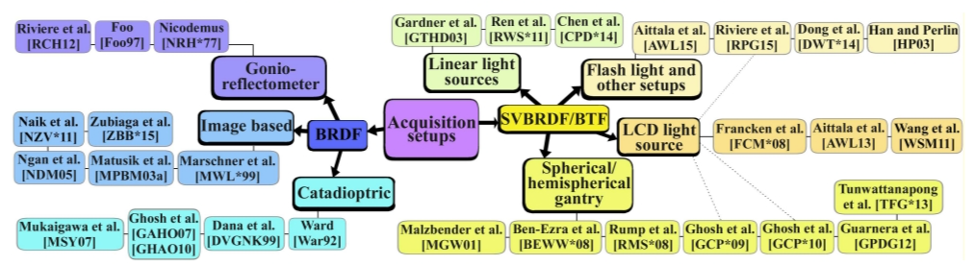
Acquisition setup

Slide 4
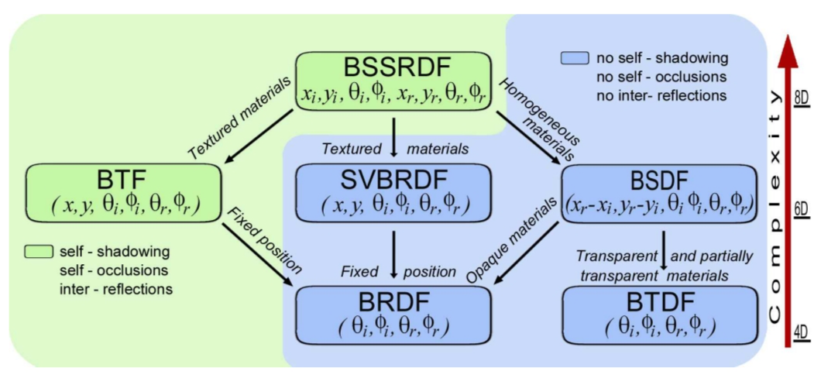
BXDF taxonomy

Slide 5
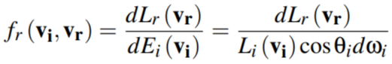
BRDF
Acquiring Parameters for Rendering
http://web.cs.wpi.edu/~emmanuel/courses/cs563/write_ups/zackw_measurement.html
Notes:
Explain the reflectance equation.
Lr = reflected radiance
Ei = incoming irradiance

Slide 6
Storing measurement
Uniform and Non-uniform grid - This naive approach stores the sample points directly as a grid. To obtain the BRDF values between sample points neighboring sample points much be interpolated. One approach uses quadrilinear interpolation in which the 4 neighboring sample points are interpolated. This approach doesn't provide tangential continuity. Also, interpolation for non-uniform grids are more difficult.
Interpolating Spline - Fits an interpolating spline through the sample points. This approach provides smooth interpolation between sample points but often introduces high frequency noise due to oscillations in the curve. The noise shows up as artifacts in rendering.
B-Spline - Uses the sample points as control points for the spline. It provides smooth interpolation but the BRDF values at the sample points are not the original measured values.
Spherical Harmonics - This common technique represents BRDFs as a infinite sum of spherical harmonic basis functions. Large number of terms are needed to accurately represent general BRDFs and this technique also introduces high frequency noise. There are several techniques for noise reduction that are used.
Wavelets - Wavelets are basis functions that are good at representing signals that contain a great deal of high frequency signals in some areas while little in others. Wavelets are very attractive for storing BRDFs for this reason. Wavelets also provide good compression while introducing little error.
Notes:
What’s the problem of measured data ?
Continuous → we need discrete data.
Storing discrete data (in this slide)

Slide 7
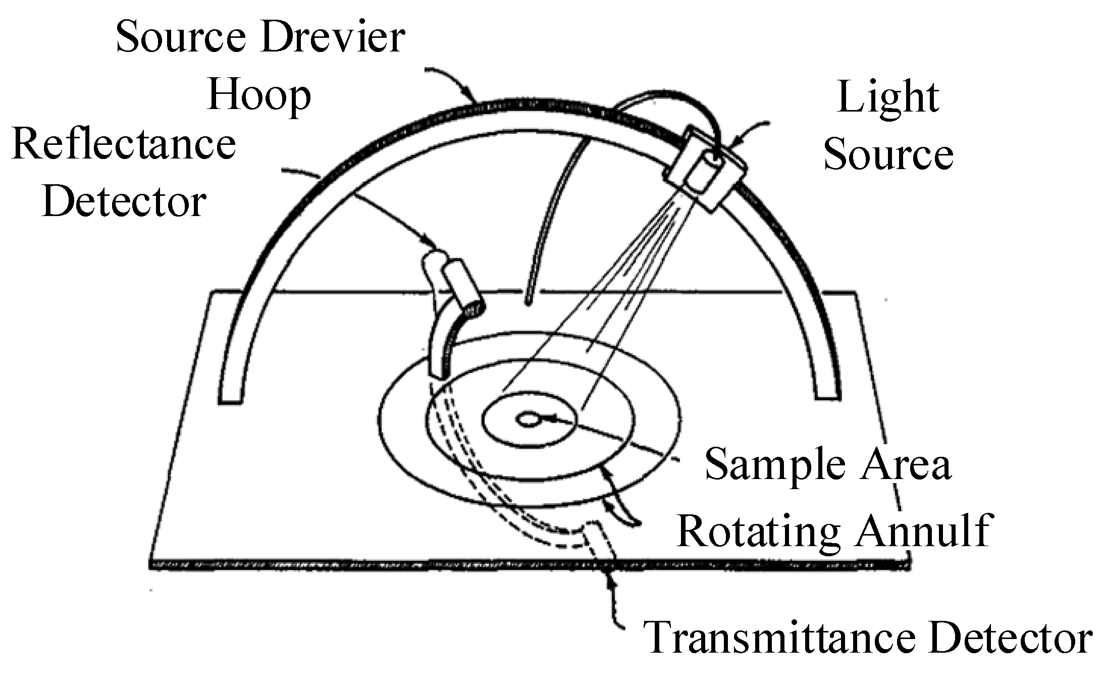
Gonio-reflectometer

Slide 8
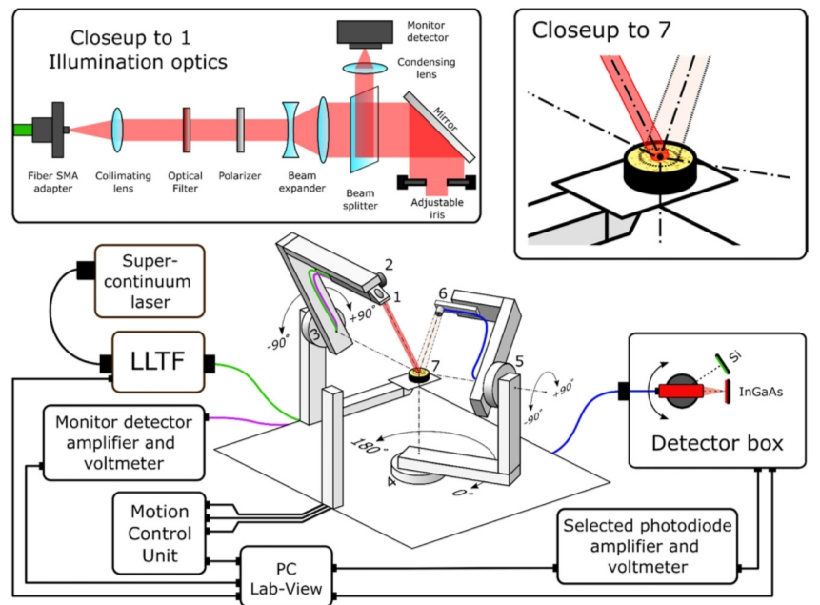
Illustrations of a gonio-reflectometer

Slide 9
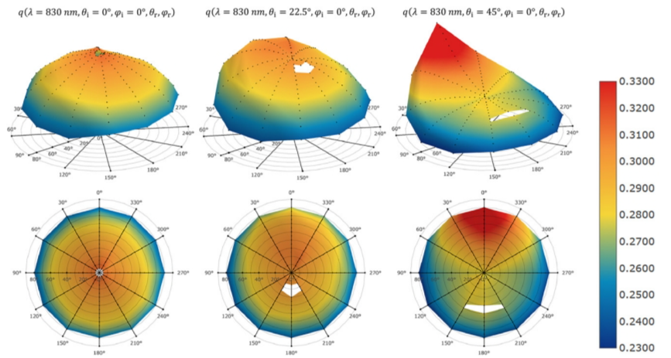
Visualization of the examples
Notes:
Explain these plots.
[Class participation] – What are the white holes (regions) ?

Slide 10
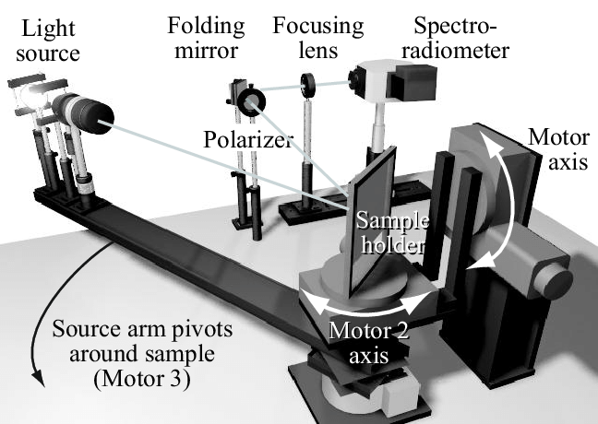
A gonio-reflectometer

Slide 11
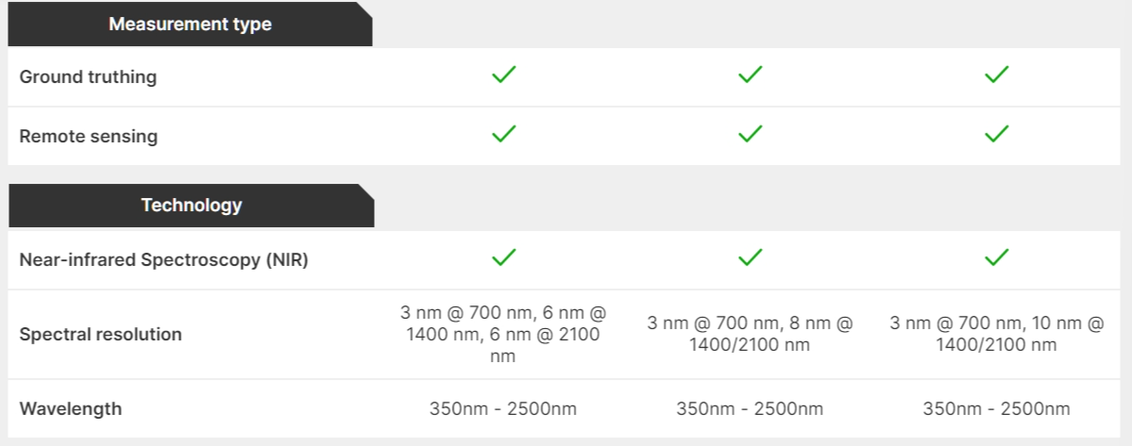
Spectro radiometer spec
https://www.malvernpanalytical.com/en/products/product-range/asd-range/fieldspec-range?utm_source=google&utm_medium=cpc&utm_campaign=EN%20-%20ISEAA%20-%20Search&utm_term=field%20spectroradiometer&utm_content=EN%20-%20Product%20Category%20-%20Spectroradiometers&gad_source=1&gclid=CjwKCAiAlcyuBhBnEiwAOGZ2S25v9Z21wpXDTpq5EgroBiqY9F1Ut_eeJZK12Uvf_1VKe8GyqRAH7xoCXc0QAvD_BwE
Notes:
Check out the spectral resolution

Slide 12
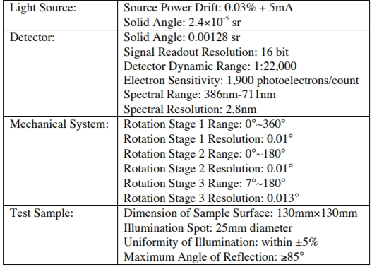
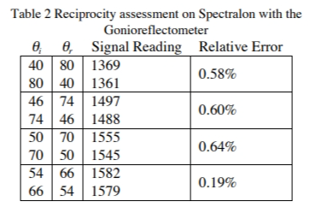
Specs
Notes:
Left table → resolution of each device
Right table → check reciprocity property

Slide 13
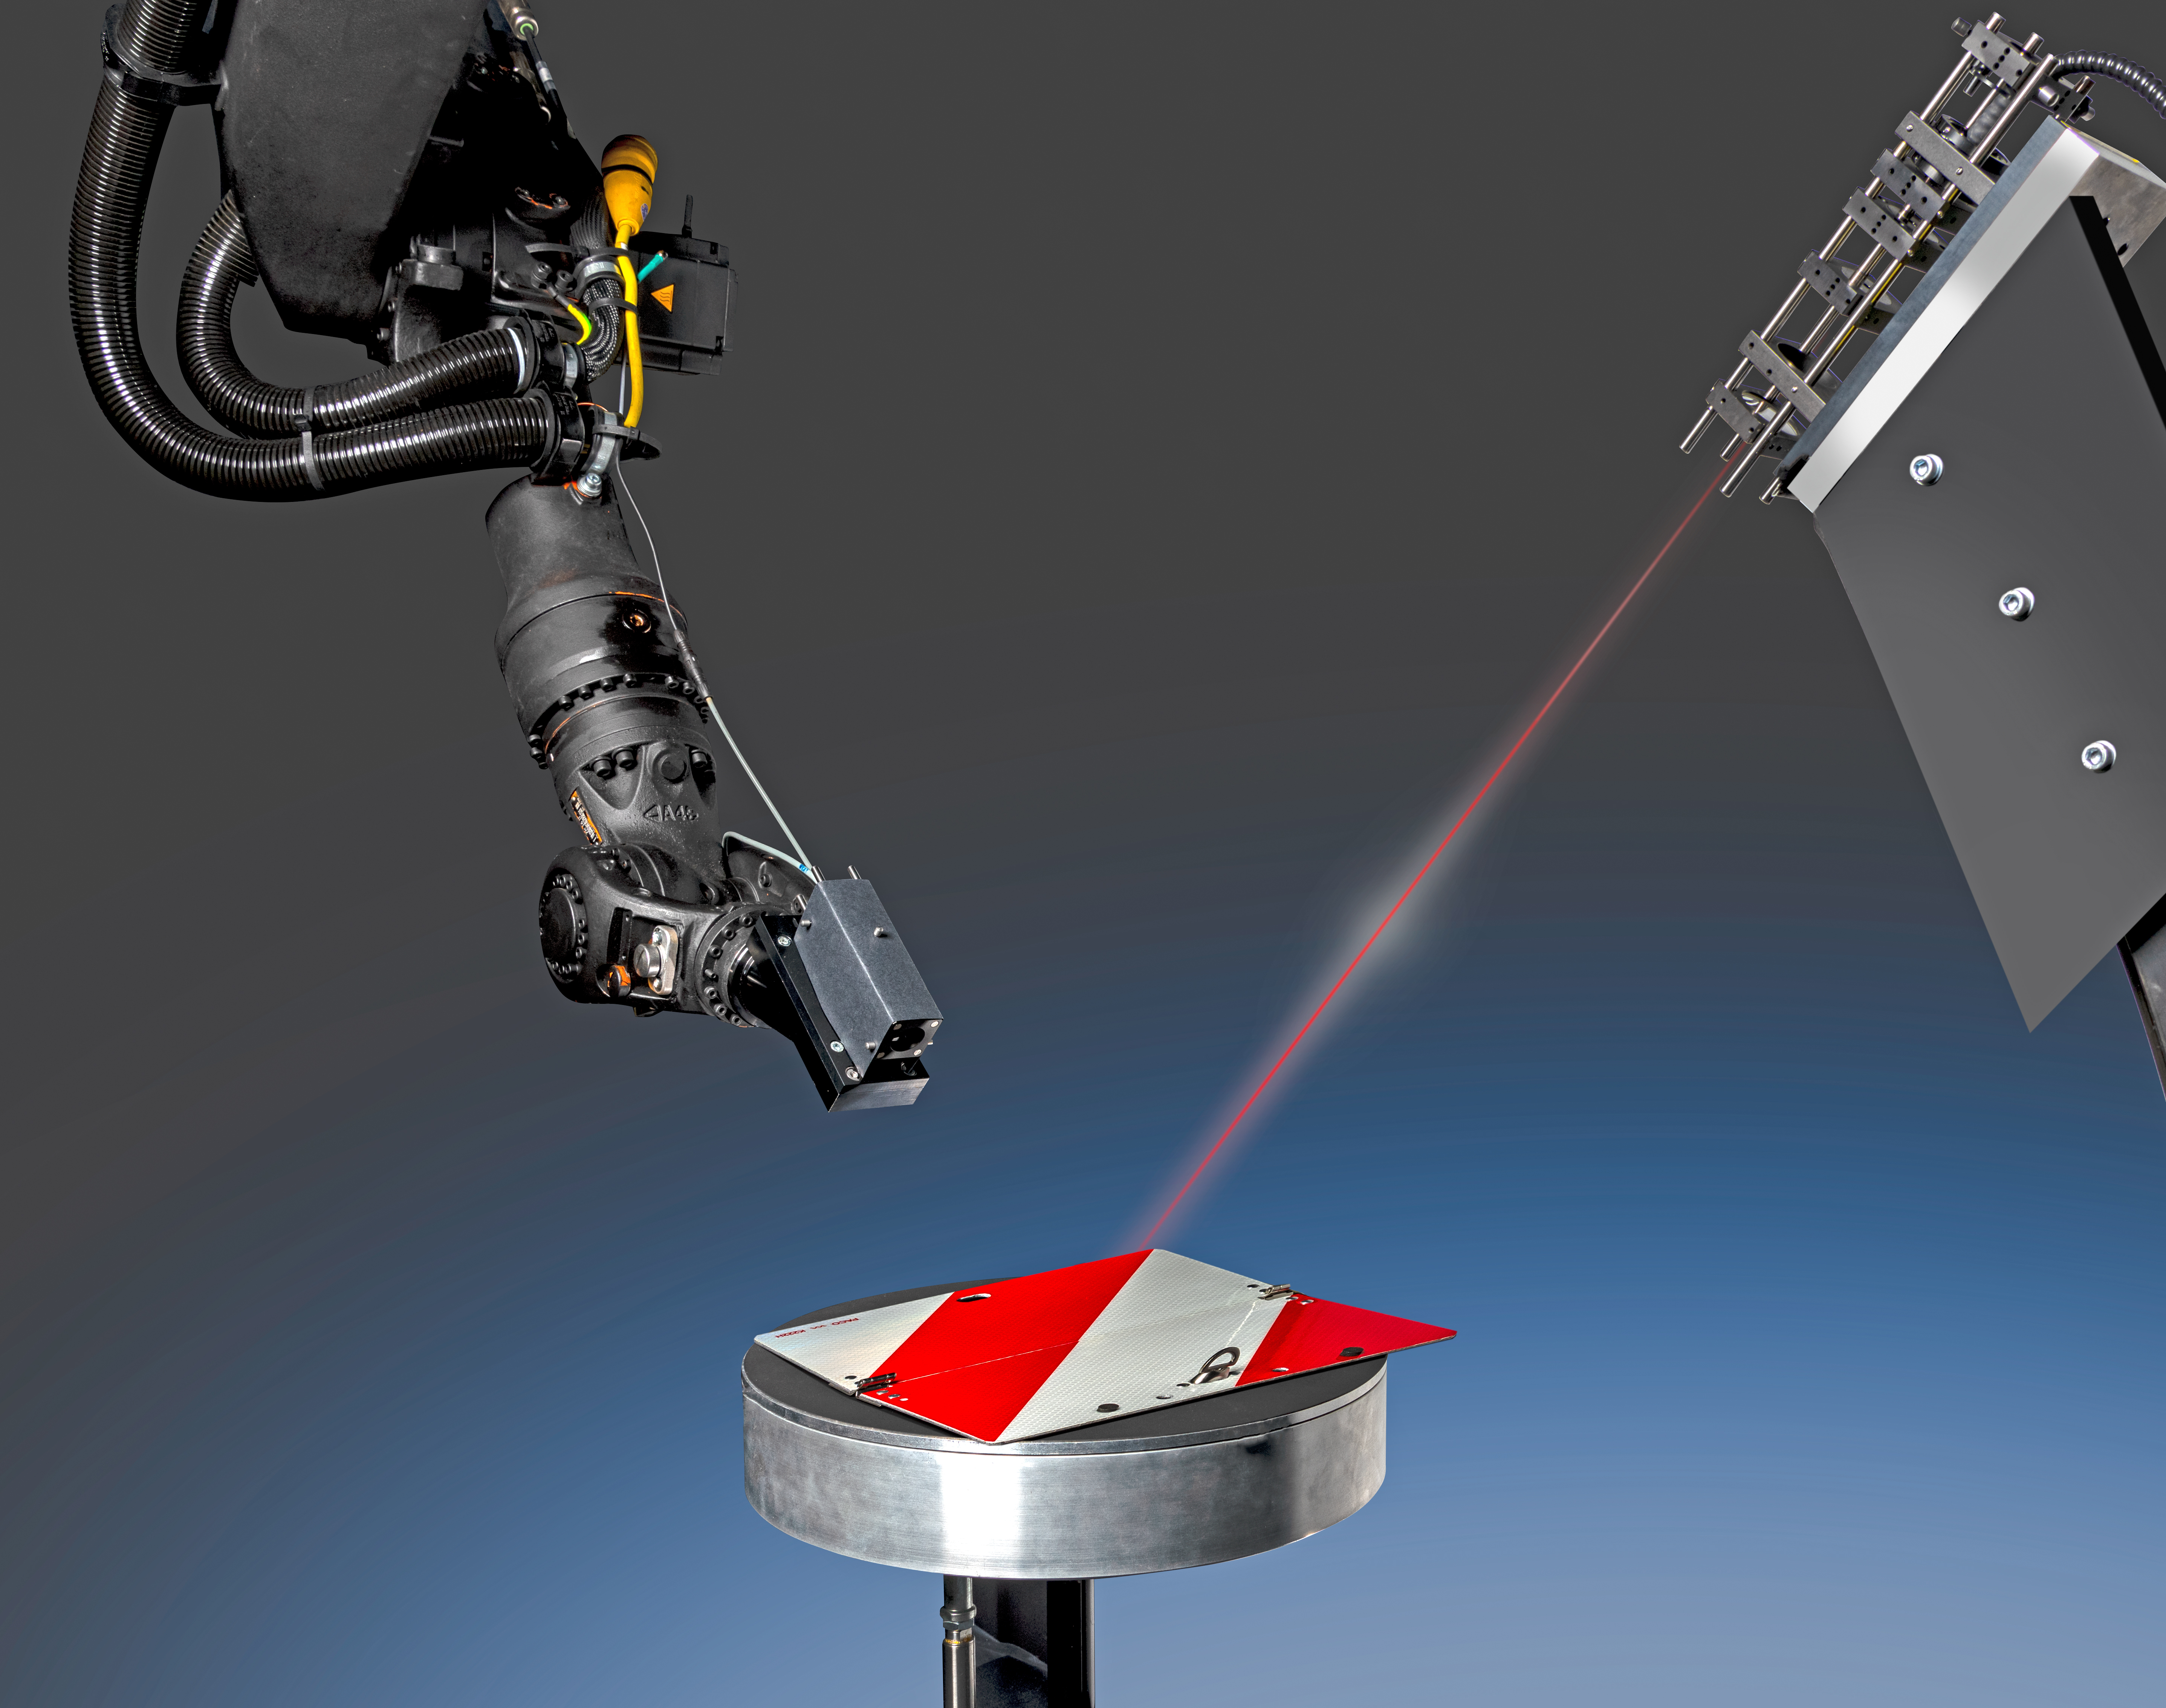
Fraunhofer gonio-reflectometer
https://www.iosb.fraunhofer.de/en/projects-and-products/sig_brdf_measurement/gonioreflektometer-messanlage.html
Notes:
Watch the video clip.

Slide 14
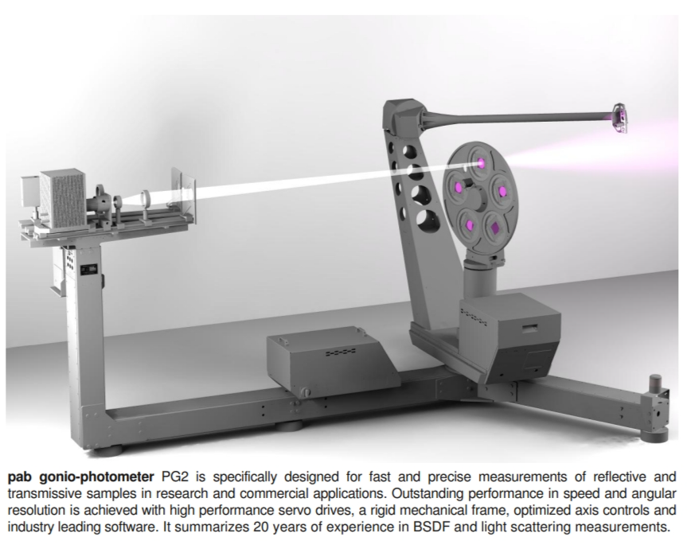
Gonio­Photometer for BSDF reflection & transmission measurements
http://www.pab.eu/docs/PG2-flyer-en.pdf
Notes:
This device can capture transmission

Slide 15
Gonio-photometer in action

Slide 16
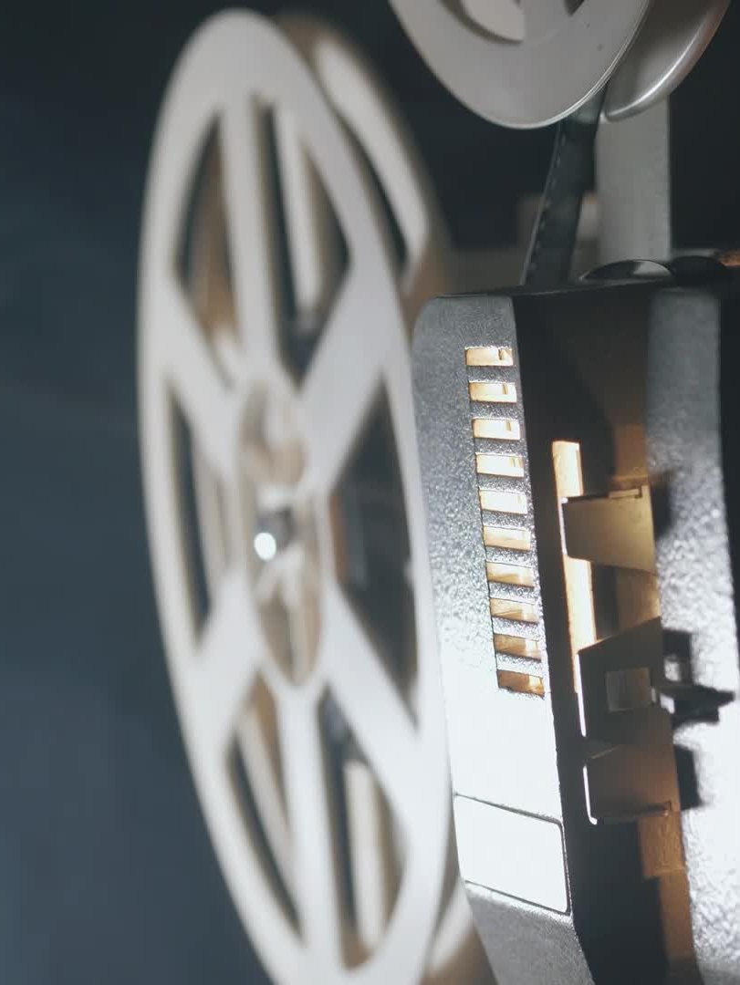
Keys of gonio-reflectometer setup
Equipment
Sensor
Light source
Mechanical arms
Sample holder
Configurations
Move light source and sensor but fix sample.
Move light source and sample but fix sensor.
Move everything !

Slide 17
Image-based measurement
Extended use of imaging technology
Capturing multiple samples at a time
Cheaper equipment cost
Leverage the use of material shape
Notes:
Imaging technology = array of sensors
Leveraging of capturing algorithms = multiple input and output directions

Slide 18
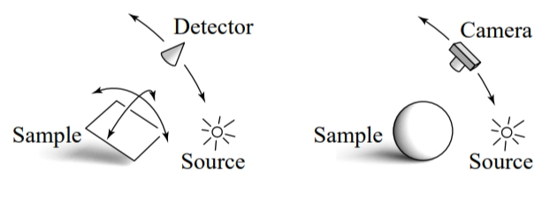
Image-based configuration

Slide 19
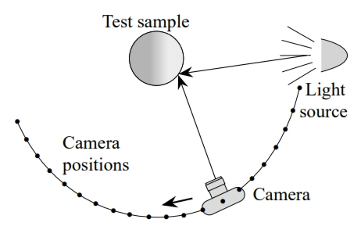
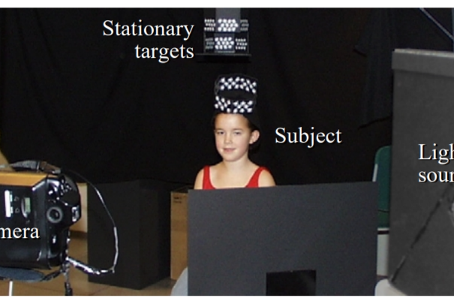
Marchner et al. proposed
https://www.cs.cornell.edu/~srm/publications/EGRW99-brdf.pdf

Slide 20
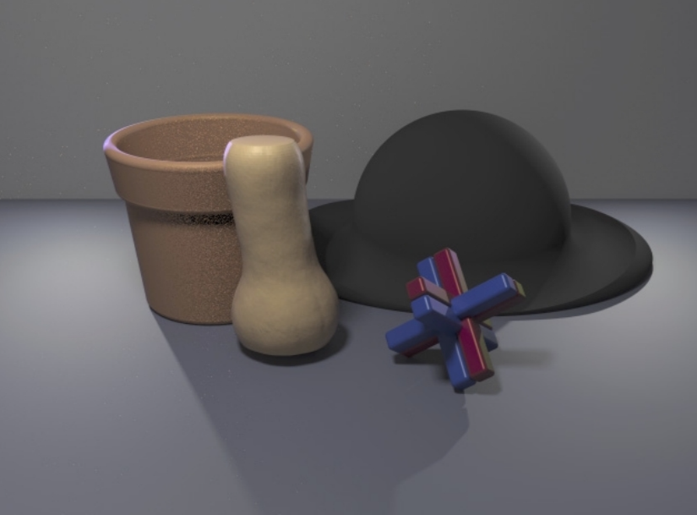
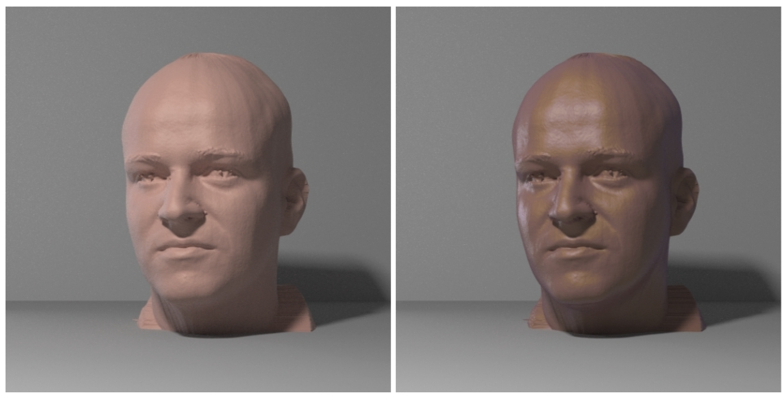
Results

Slide 21
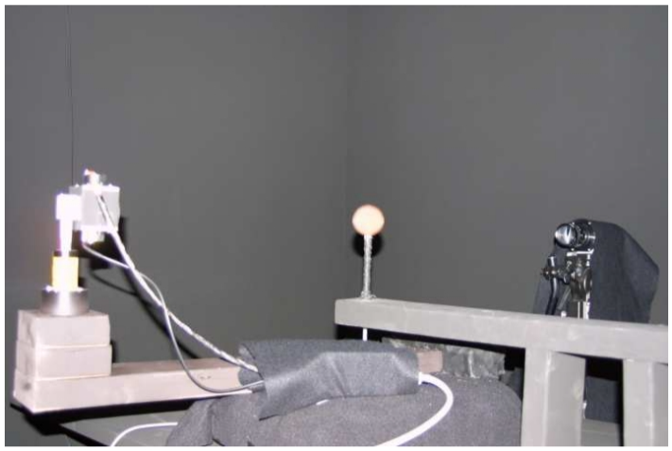
Matusik et al. proposed
https://www.merl.com/publications/docs/TR2003-83.pdf

Slide 22
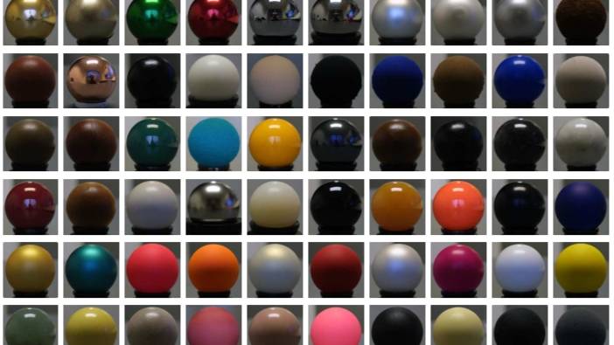

Slide 23
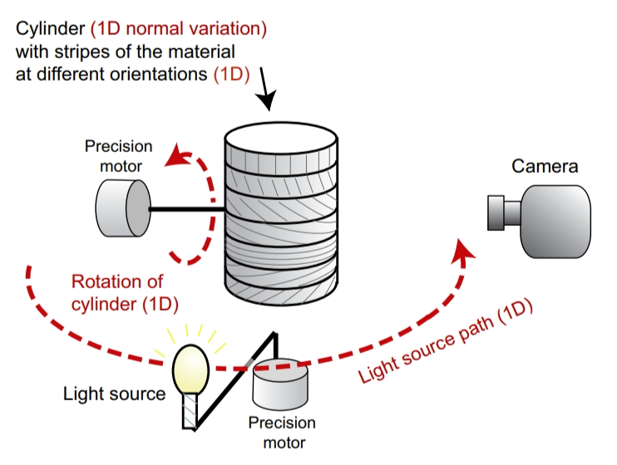
An image-based anisotropic BRDF acquisition
https://people.csail.mit.edu/addy/research/ngan05_brdf_eval.pdf

Slide 24
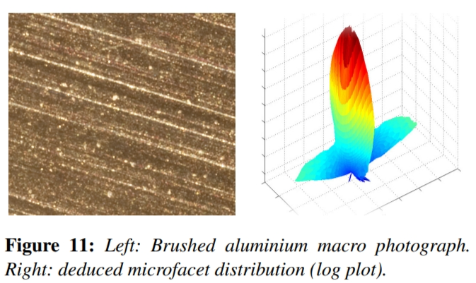
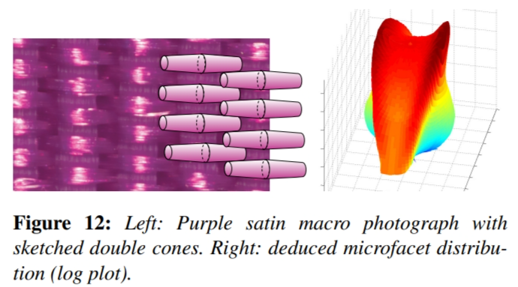
BRDF Fitting

Slide 25
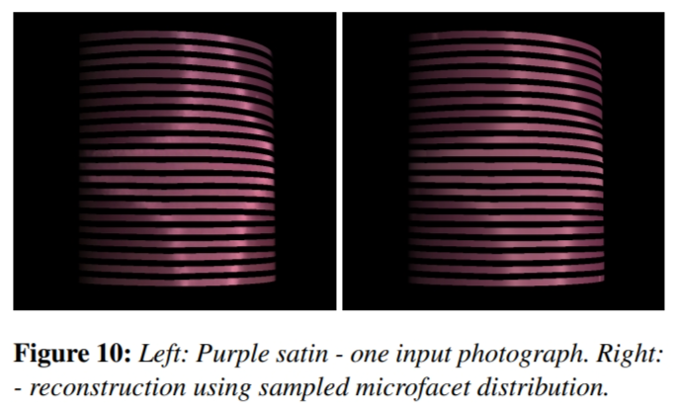
Microfacet BRDF fitting on measured samples

Slide 26
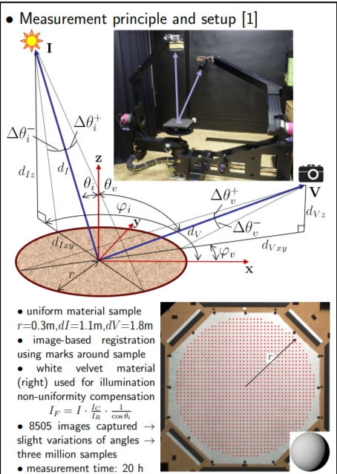
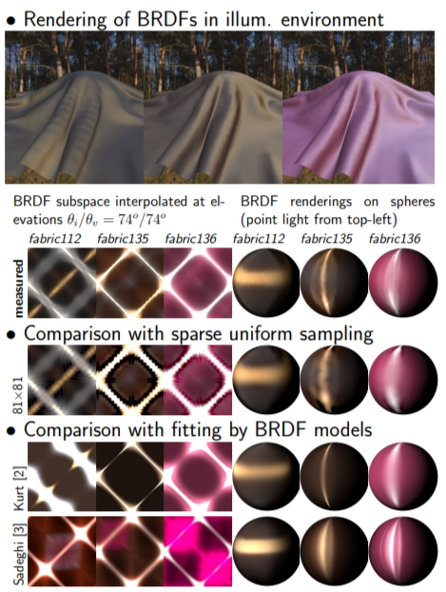
Anisotropic BRDF acquisition - UTIA
Poster
UTIA

Slide 27
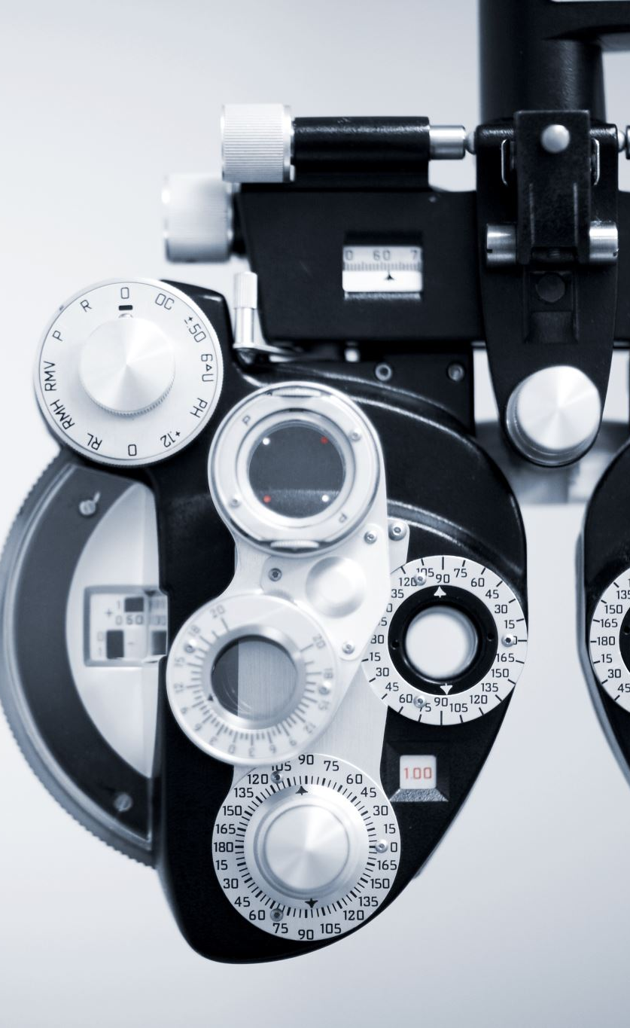
Catadioptric measurement setup
Keys to setup
Catadioptric optical systems makes use of both reflected and refracted light, in order to reduce aberrations.
The resulting imaging setups are generally efficient image based BRDF acquisition devices, usually without any moving parts.
Invented reflection objects to handle various scattering situations.
Notes:
Want to remove / reduce parts of the capturing device + speed up the capturing process.

Slide 28
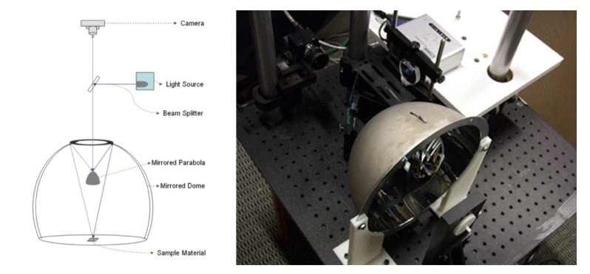
Parabolic mirrors

Slide 29
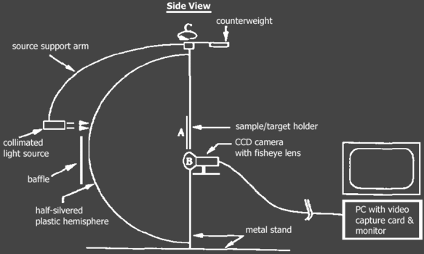
Hemispherical mirror

Slide 30
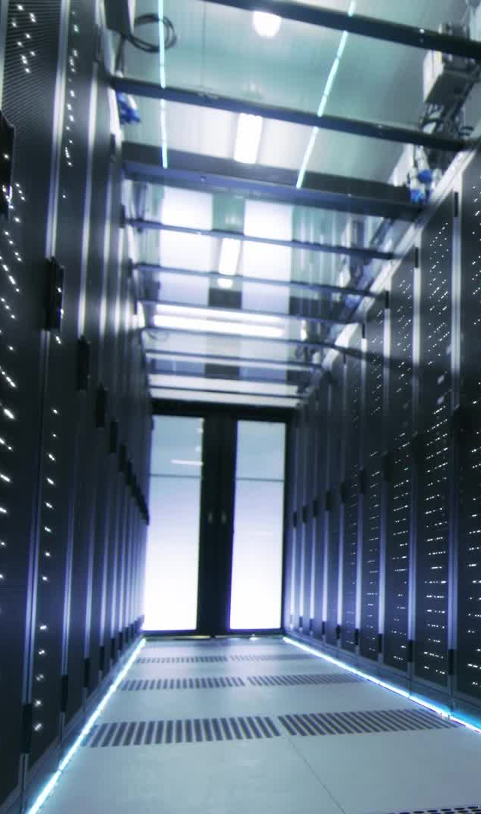
SVBRDF / BTF capturing
Very challenging as they (SVBRDF, BTF) are high-dimensional data.
The combinations for dense sampling are far more than BRDF dense sampling.
The storage size is huge.
It takes time to capture a material.
Bonn BTF dataset, Bonn SVBRDF dataset
SVBRDF dataset
UTIA BTF dataset

Slide 31

Material estimation
ControlMat: Controlled Generative Approach to Material Capture
MatFusion: A Generative Diffusion Model for SVBRDF Capture
Single-Image SVBRDF Capture with a Rendering-Aware Deep Network
Guided Fine-Tuning for Large-Scale Material Transfer

Slide 32
How to obtain BRDF values from LDR images ?

Slide 33
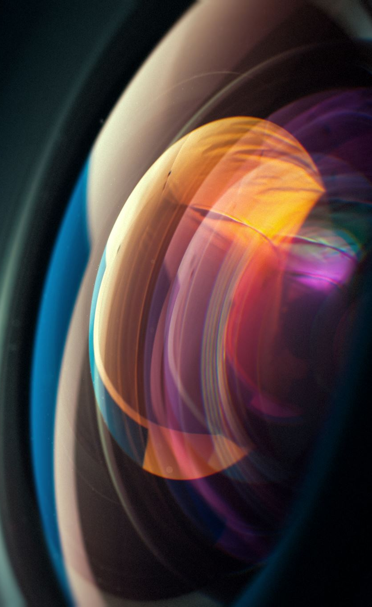
Computing BRDF values from LDR images
There are many steps in order to obtain BRDF values from captured images.
Steps to obtain radiance value from a HDR image
Camera calibration (done once)
Capturing LDR images with multi-exposure
Combining LDR images (at a position) to a HDR image
Compute radiance from a HDR image
Steps to obtain a BRDF value
Measure a target material
Measure a spectralon at the same locations
Compute a BRDF value from the measurements
Notes:
Explain HDR imaging technology

Slide 34
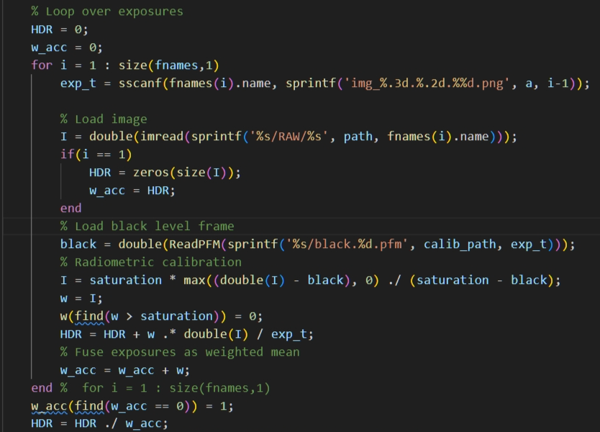
HDR image from LDR images
Acknowledge : Saghi Hajisharif, Behnaz Kavoosi, Computer Graphics research group at LiU.

Slide 35
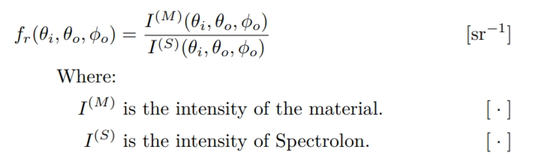
BRDF computation related to Spectralon
https://orbit.dtu.dk/files/128903442/phd435_Nielsen_JB_reduced3.pdf
Notes:
Spectralon = …
Measuring both spectralon reflectance and material reflectance.
Spectralon reflectance = baseline

Slide 36
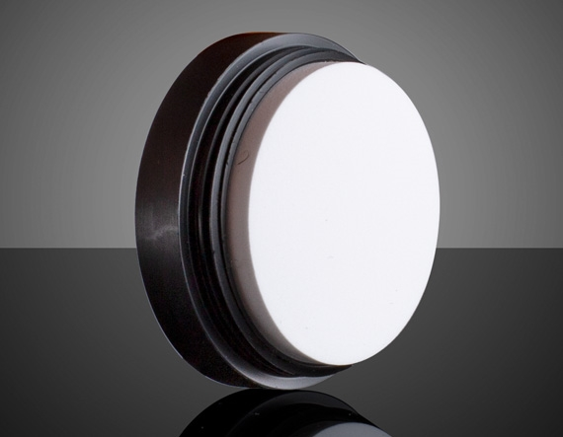
Spectralon

